Slide 1

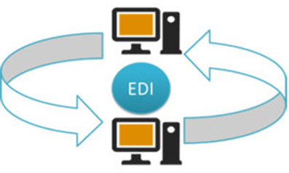
EDI AND ITS TYPES

Slide 2
WHAT IS EDI ?
EDI is known as Electronic Data Interchange (EDI)
Electronic Data Interchange (EDI) is the electronic interchange of business information using a standardized format; a process which allows one company to send information to another company electronically rather than with paper. Business entities conducting business electronically are called trading partners.

Slide 3
BUSINESS DOCUMENTS CAN BE EXCHANGED USING EDI
Two most common are purchase orders and invoices. At a minimum, EDI replaces the mail preparation and handling associated with traditional business communication. However, the real power of EDI is that it standardizes the information communicated in business documents, which makes possible a "paperless" exchange.

Slide 4
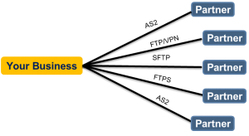
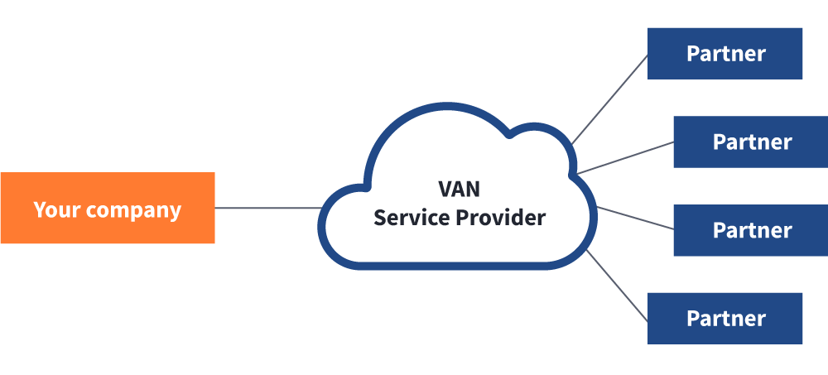
TYPES OF EDI
Direct EDI/Point-to-Point :
Brought to prominence by Walmart, direct EDI, sometimes called point-to-point EDI, establishes a single connection between two business partners. In this approach, you connect with each business partner individually. It offers control for the business partners and is most commonly used between larger customers and suppliers with a lot of daily transactions.
EDI via VAN :
Value Added Networks (VANs) are private networks where electronic business documents are exchanged between partners. The VAN provider manages the network and provides companies with mailboxes where they can send and receive EDI documents.

Slide 5
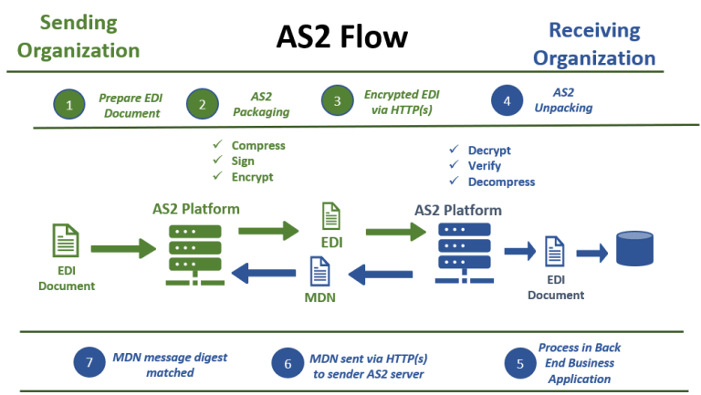
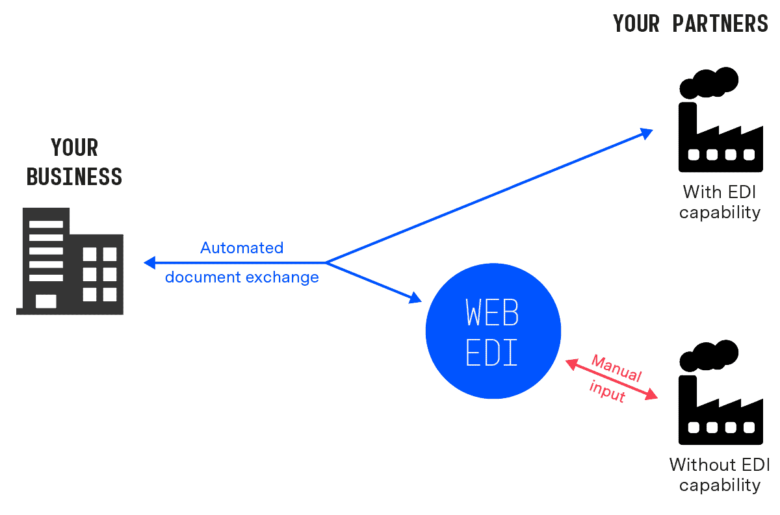
EDI via AS2 :
AS2 is one of the most popular methods for transporting data, especially EDI data, securely and reliably over the Internet. It essentially involves two computers – a client and a server – connecting in a point-to-point manner via the web. AS2 creates an “envelope” for the EDI data, allowing it to be sent securely – using digital certificates and encryption – over the Internet.
Web EDI :
Unlike EDI via AS2, Web EDI conducts EDI using a standard Internet browser. Organisations use different online forms to exchange information with business partners. Web EDI makes EDI easy and affordable for small- and medium-sized organisations and companies that have only occasional need to utilise such a service.

Slide 6
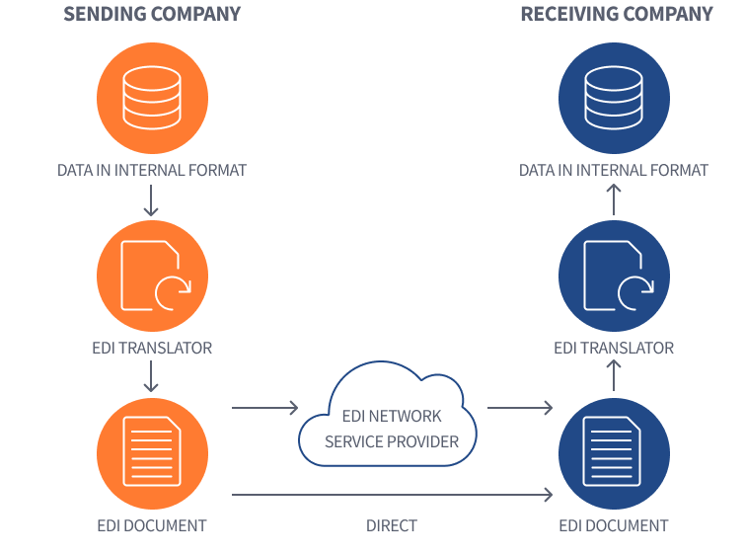
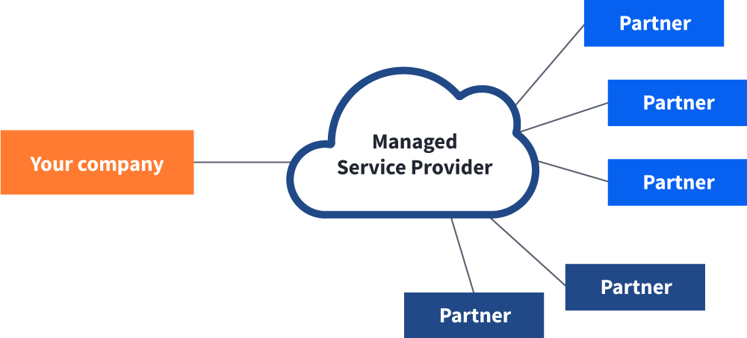
Mobile EDI :
Users have commonly accessed EDI either by a private network such as Value Added Network or the Internet in order to send and receive EDI-related business documents. Mobile EDI has had limited adoption, in part due to security concerns with mobile devices across an EDI infrastructure, but mainly due to the mobile devices themselves. The quality and size of the screen of most devices has been relatively poor until recently. There is a growing industry for developing software applications or ‘apps’ for downloading onto mobile devices and it will be only be a matter of time before you will be able to download supply chain and EDI related apps from private or corporate app stores.
EDI Outsourcing :
EDI Outsourcing (also referred to as Managed Services) is a fast-growing option that enables companies to use external resources to manage their EDI environment on a day-to-day basis. This is in part driven by companies wanting to integrate to back office business systems such as Enterprise Resource Planning (ERP) platforms. Many companies do not have the internal resources to undertake this type of work so they outsource it instead.

Slide 7


